Slide 1
20241219 LP-T1 run T05 step6 pressure up

Slide 2
Discipline 1. 選定團隊 Form the Team
團隊負責人Team Leader/Dept.:
成員Team Member/Dept.:
Name | Department | Position
S210
S220

Slide 3
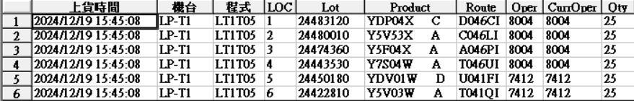
Discipline 2.描述問題及現況掌握Describe the Problem
(WHO detected the problem? WHAT is wrong? State the problem in terms of object and defect. WHERE the problem was first detected, describe location of the detection, lot #, WHEN and HOW it was detected)
What | Route : as table Product : as table Lot number : as table Qty: 6 lot / 150 pcs
Where | LP-T1
When | 2024.12.19
Extent | Run T0T STEP-6 PRESSURE UP RECIPE ABORT, PTC:0 TOX =0A

Slide 4
Run cards at impact station
將有問題的站點前後 run cards 貼上

Slide 5
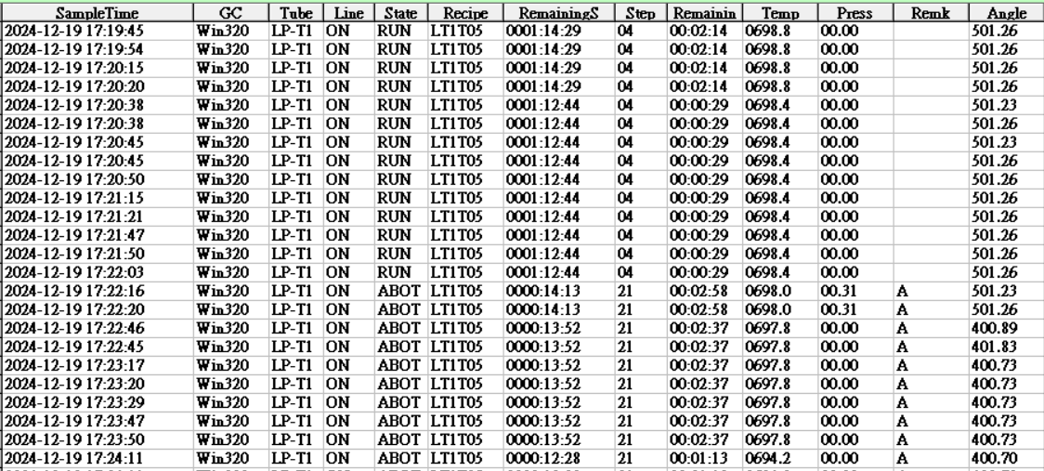
Discipline 2.描述問題及現況掌握Describe the Problem
(WHO detected the problem? WHAT is wrong? State the problem in terms of object and defect. WHERE the problem was first detected, describe location of the detection, lot #, WHEN and HOW it was detected)
RMS 無抓到 step-5 壓力

Slide 6
Discipline 2.描述問題及現況掌握Describe the Problem
(WHO detected the problem? WHAT is wrong? State the problem in terms of object and defect. WHERE the problem was first detected, describe location of the detection, lot #, WHEN and HOW it was detected)
S220 EQ check machine :
check cap 石英有些許白點,clean ok
cap 升上 pump down 底壓 0.00 LK:0.04 torr/70sec
抓漏 230 o-ring 有漏(3.0e-8 →5.0e-6),replace 230 o-ring ok
抓漏無漏源 LK 0.00 → 0.02 torr/70sec
test run TO5
產品處理 : ptc:6及tox:5A for PE check

Slide 7
Discipline 3.執行及驗證暫時防堵對策 Contain the Problem
(Define and implement containment actions to isolate the effect of problem from any internal/external customer until corrective action is implemented)
3.1 異常產品 (Defect Lots)
項目 Item | 處理方式 Action | 負責人員 Resp | 預定完成日 Due | 實際完成日 Imp. | 處理結果 Verification
3.2 波及產品 (Impact Lots)
項目 Item | 處理方式 Action | 負責人員 Resp | 預定完成日 Due | 實際完成日 Imp. | 處理結果 Verification
No | No | No | No | No | No

Slide 8
Discipline 3.執行及驗證暫時防堵對策 Contain the Problem
(Define and implement containment actions to isolate the effect of problem from any internal/external customer until corrective action is implemented)
3.3 波及設備 (Impact Machine)
項目 Item | 處理方式 Action | 負責人員 Resp | 預定完成日 Due | 實際完成日 Imp. | 處理結果 Verification
3.4 波及製程 (Impact Route) : 是(YES)/否(No)
項目 Item | 處理方式 Action | 負責人員 Resp | 預定完成日 Due | 實際完成日 Imp. | 處理結果 Verification
No | No | No | No | No | No
3.5 產品召回選項，是否需進行客戶端波及產品的召回?是(YES)/否(No)
Customer | Product No. | Lot number / Wafer number | Approx. Quantity
No | No | No | No

Slide 9
Discipline 4.定義及驗證真因 (Identify the Root Cause)
(Identify all potential causes which could explain why the problem occurred)
4.1 Non-conformance root cause (defect nature / technical root cause):
a) Failure mechanism:

Slide 10
Discipline 4.定義及驗證真因 (Identify the Root Cause)
(Identify all potential causes which could explain why the problem occurred)
4.1 Non-conformance root cause (defect nature / technical root cause):
b) 列出所有可能的原因 (Probable Causes/Factors): Non-conformance
工具 (Tools): 故障樹分析 (Fault Tree Analysis)、魚骨圖 (Fishbone)

Slide 11
Discipline 4.定義及驗證真因 (Identify the Root Cause)
(Identify all potential causes which could explain why the problem occurred)
4.1 Non-conformance root cause (defect nature / technical root cause):
c) 真因驗證 (Root Cause Verification)

Slide 12
Discipline 4.定義及驗證真因 (Identify the Root Cause)
(Identify all potential causes which could explain why the problem occurred)
4.1 Non-conformance root cause (defect nature / technical root cause):
c) 真因驗證 (Root Cause Verification)

Slide 13
Discipline 4.定義及驗證真因 (Identify the Root Cause)
(Identify all potential causes which could explain why the problem occurred)
4.1 Non-conformance root cause (defect nature / technical root cause):
c) 真因驗證 (Root Cause Verification)

Slide 14
Discipline 4.定義及驗證真因 (Identify the Root Cause)
(Identify all potential causes which could explain why the problem occurred)
4.1 Non-conformance root cause (defect nature / technical root cause):
c) 真因驗證 (Root Cause Verification)

Slide 15
Discipline 4.定義及驗證真因 (Identify the Root Cause)
(Identify all potential causes which could explain why the problem occurred)
4.2 Non-detection / escape root cause (Provide reason to why the current system failed to detect)
a) 5-why:
b) Conclusion

Slide 16
Discipline 5.擬定及驗證永久改善對策Choose and verify permanent corrective action (列出各項執行之對策並檢核其對策有效性)
5.1 What was the chosen corrective action to correct the root cause? (Add photo or diagram where applicable.)

Slide 17
Discipline 5.擬定及驗證永久改善對策Choose and verify permanent corrective action (列出各項執行之對策並檢核其對策有效性)
5.2 Verification of actions effectiveness

Slide 18
Discipline 6.實施認永久改善對策Corrective Actions Implementation
6.1 For non-conformance root cause (defect nature / technical root cause):
Nbr. | Actions | Who | When | Remarks / Evidence (Document/Spec/Chart #)
6.2 For non-detection / escape root cause
Nbr. | Actions | Who | When | Remarks / Evidence (Document/Spec/Chart #)

Slide 19
Discipline 7.避免再發Prevent Recurrence (Modify System / Document)
7.1 Systemic Actions:
Factor | Actions | Who | When | Remarks / Evidence (Document/Spec/Chart #)
Practices/ Training
Work Instruction
Specification
Control Plan
* FMEA (must)
Error Proofing

Slide 20
Discipline 7.避免再發Prevent Recurrence (Modify System / Document)
FMEA new item:
Item | Potential Failure Mode | Potential Effect(s) of Failure | S. E. V. | C L A S S. | Potential cause(s) / mechanism(s) of Failure | O. C. C. | Current Process Control Prevention | Current Process Controls Detection | D. E. T. | R. P. N. | Recommended Action | Responsibility & Target Completion Date | Action Results
Process, Function, Requirements |  |  |  |  |  |  |  |  |  |  |  |  | Actions Taken | S. E. V. | O. C. C. | D. E. T. | R. P. N.

Slide 21
Discipline 7.避免再發Prevent Recurrence (Modify System / Document)
7.2 Corrective Actions Fan-out: (水平展開):
Machine/ Process/ Product | Actions | Responsible | Due date

Slide 22
Discipline 8. Congratulate the Team
Thanks for every member helped in this case.
Reviewed and Approved by:
Name | 2. Position | 3. Date

